Slide 1

Presentation
By - Ashok Pandey
Producer, CEO - Revel Films
ashok.pandey@revel-films.com +919833735506

Slide 2
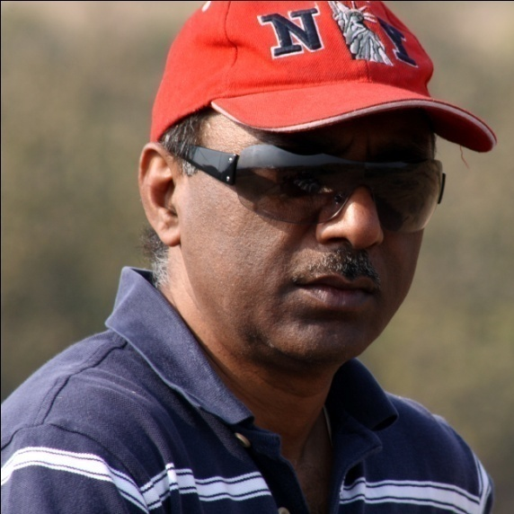
PRODUCER- ASHOK PANDEY
Chairman & CEO, Revel Films
Successful Entrepreneur having built and
run a Multinational IT business
BE (EEE) – BITS Pilani, MS (Comp Sc) – USA
Produced PHAS GAYE RE OBAMA (2010)
SAARE JAHAAN SE MEHNGA (2013)

Slide 3

CREATIVE PRODUCER- PRAGATI PANDEY
Co-founder, Revel Films
Theater artist having produced plays and performed extensively in Mumbai with playwrights like Dinesh Thakur.
Acted in Films - Phas Gaye Re Obama and Saare Jahaan Se Mehnga
Conducted Bollywood artist shows in USA.
Trained as an actor at Kreating Charakters
Education – B. Com.

Slide 4






PHAS GAYE RE OBAMA – Released 2010

Slide 5

SAARE JAHAAN SE MEHNGA – Released 2013
MEDIA Loves it...
“Brilliant Concept, earnest performances and clean humour “– Times of India
“The film is a humorous take on inflation and has robust energy-inducing music…This is definitely a film worth watching and especially because it has the power to get the arm-chair critics out of their safe zones and jumping into protest mode” Resonating Satire - The Free Press Journal
“It mainlines the characters and their constricted lives with compassion and knowledge, and makes it a surprisingly watchable film..” Value for Money - Indian Express
“Oh, what a wonderful feeling when a film you have zero expectations from surprises you with its sweet honesty…”Delightful Honesty - Deccan Chronicle
BOLLYWOOD Loves it..
“Very honest & original film, entertaining and thought provoking…thoroughly enjoyed after a long time” - Raj Kumar Santoshi
“Loved the film, very well produced “– Sajid Nadiadwala
Loved it! Sanjay Mishra rocks it again. ” – Subhash Kapoor
“An honest effort ..with very identifiable moments” – Raj Kumar Gupta
“Thought provoking and relatable..A Must watch” - Luv Ranjan
“We want to give a U certificate so everyone in the country can watch this film.” -Censor Board

Slide 6
Now Producing.. “BACH GAYE RE OBAMA”
Tentative Title Bach Gaye Re Obama
Producer/Writer Ashok Pandey
Genre Comedy
Locations India + International
Potential Cast Nawazuddin Siddiqui, Boman Irani,
Sanjay Mishra, Huma Qureshi,
Manurishi Chaddha.
Shooting starts Mid 2023

Slide 7
BACH GAYE RE OBAMA - Synopsis
Bach Gaye Re Obama (BGRO) is a sequel to the hit film Phas Gaye Re Obama (PGRO). BGRO is a fast paced, fun-filled , hilarious gangster based satirical comedy in which the First Lady of the US gets kidnapped (not quite!) on the backdrop of massive corruption. The film canvas is larger in scale and scope than its prequel.
A major Defence deal is underway with a US Defence contractor - Tactical Dynamics, and a lot of people are going to make a lot of money through kickbacks…the story begins with a 20Billion dollar Defence deal that is being negotiated with India by Dick Chaudhary, an International sales agent on behalf of Tactical Dynamics. On the Indian side, the Defence Secretary Prasad under direction from Yadav, Defence Minister (DM), is leading the deal with a prime objective of making money for themselves at any cost.. The US team has convinced and brought the US President to endorse the deal, to enable a definitive closure.
The First Lady of The United States (FLOTUS) has taken advantage of this opportunity to visit India (as a part of her global mission to help eradicate poverty, poor health etc..) along with her husband. The Home Minister asks the Chief Minister of UP, Bharti Devi, to assist FLOTUS on her trip. Bharti Devi asks Bhaisaab (BS), a gangster-turned-MLA from a poor place in UP to escort the First Lady on her trip to his region.
All was going well until BS plans to kidnap FLOTUS. Instead of asking for ransom from the President of the US, BS puts the gun of ransom on the DM staking a claim on a portion of the kickbacks from this Defence deal.
Now, the story ramps up on a cat and mouse game between Yadav and BS. Alongside this wild chase, Chaudhary and Prasad continue to spice up the ‘kickback’ brew.. Yadav brings the CM into the fray, who is already in cahoots with BS.. At the same time BS is with the FLOTUS taking her to all kinds of places, having fun. The DM desperately tries to salvage the deal, without giving-in to the ransom demands from BS, who is on a trip of his own - entertaining his hostage while arm-twisting the DM into coughing up the ransom.. In this cat and mouse game, which is laced with lies, betrayal, unscrupulous and nefarious activities, who wins, what happens to FLOTUS,..does DM give-in or is BS trapped…does the CM help Yadav or BS... is Chaudhary able to make the deal while attempting to satisfy the greedy politicians…how far and deep would Yadav and Prasad go to quench their greed.. forms the crux of the film

Slide 8
BACH GAYE RE OBAMA
A GREAT FINANCIAL OPPORTUNITY
Great Brand Equity - Phas Gaye Re Obama (PGRO)
The Sequel - Bach Gaye Re Obama (BGRO) leverages the brand on a much bigger canvas
Unique Storyline – Kidnapping the First Lady of the US on corruption backdrop
Great Talent
Potential Cast – well known names like Nawazuddin Siddiqui, Boman Irani, Sanjay Mishra, Huma Qureshi, Manurishi Chaddha, Vrajesh Hirjee
Reasonable Budget – USD$2M
The Opportunity
The Brand equity coupled with a great story and made by a highly talented team in a reasonable budget forms the opportunity that BGRO is!
Potential for good Satellite and Ancilliary Rights business
PGRO audience base is very big. It would give us a good start at Theatrical Revenues
Revenue/Profit share opportunity

Slide 9
THANK YOU

